Slide 1
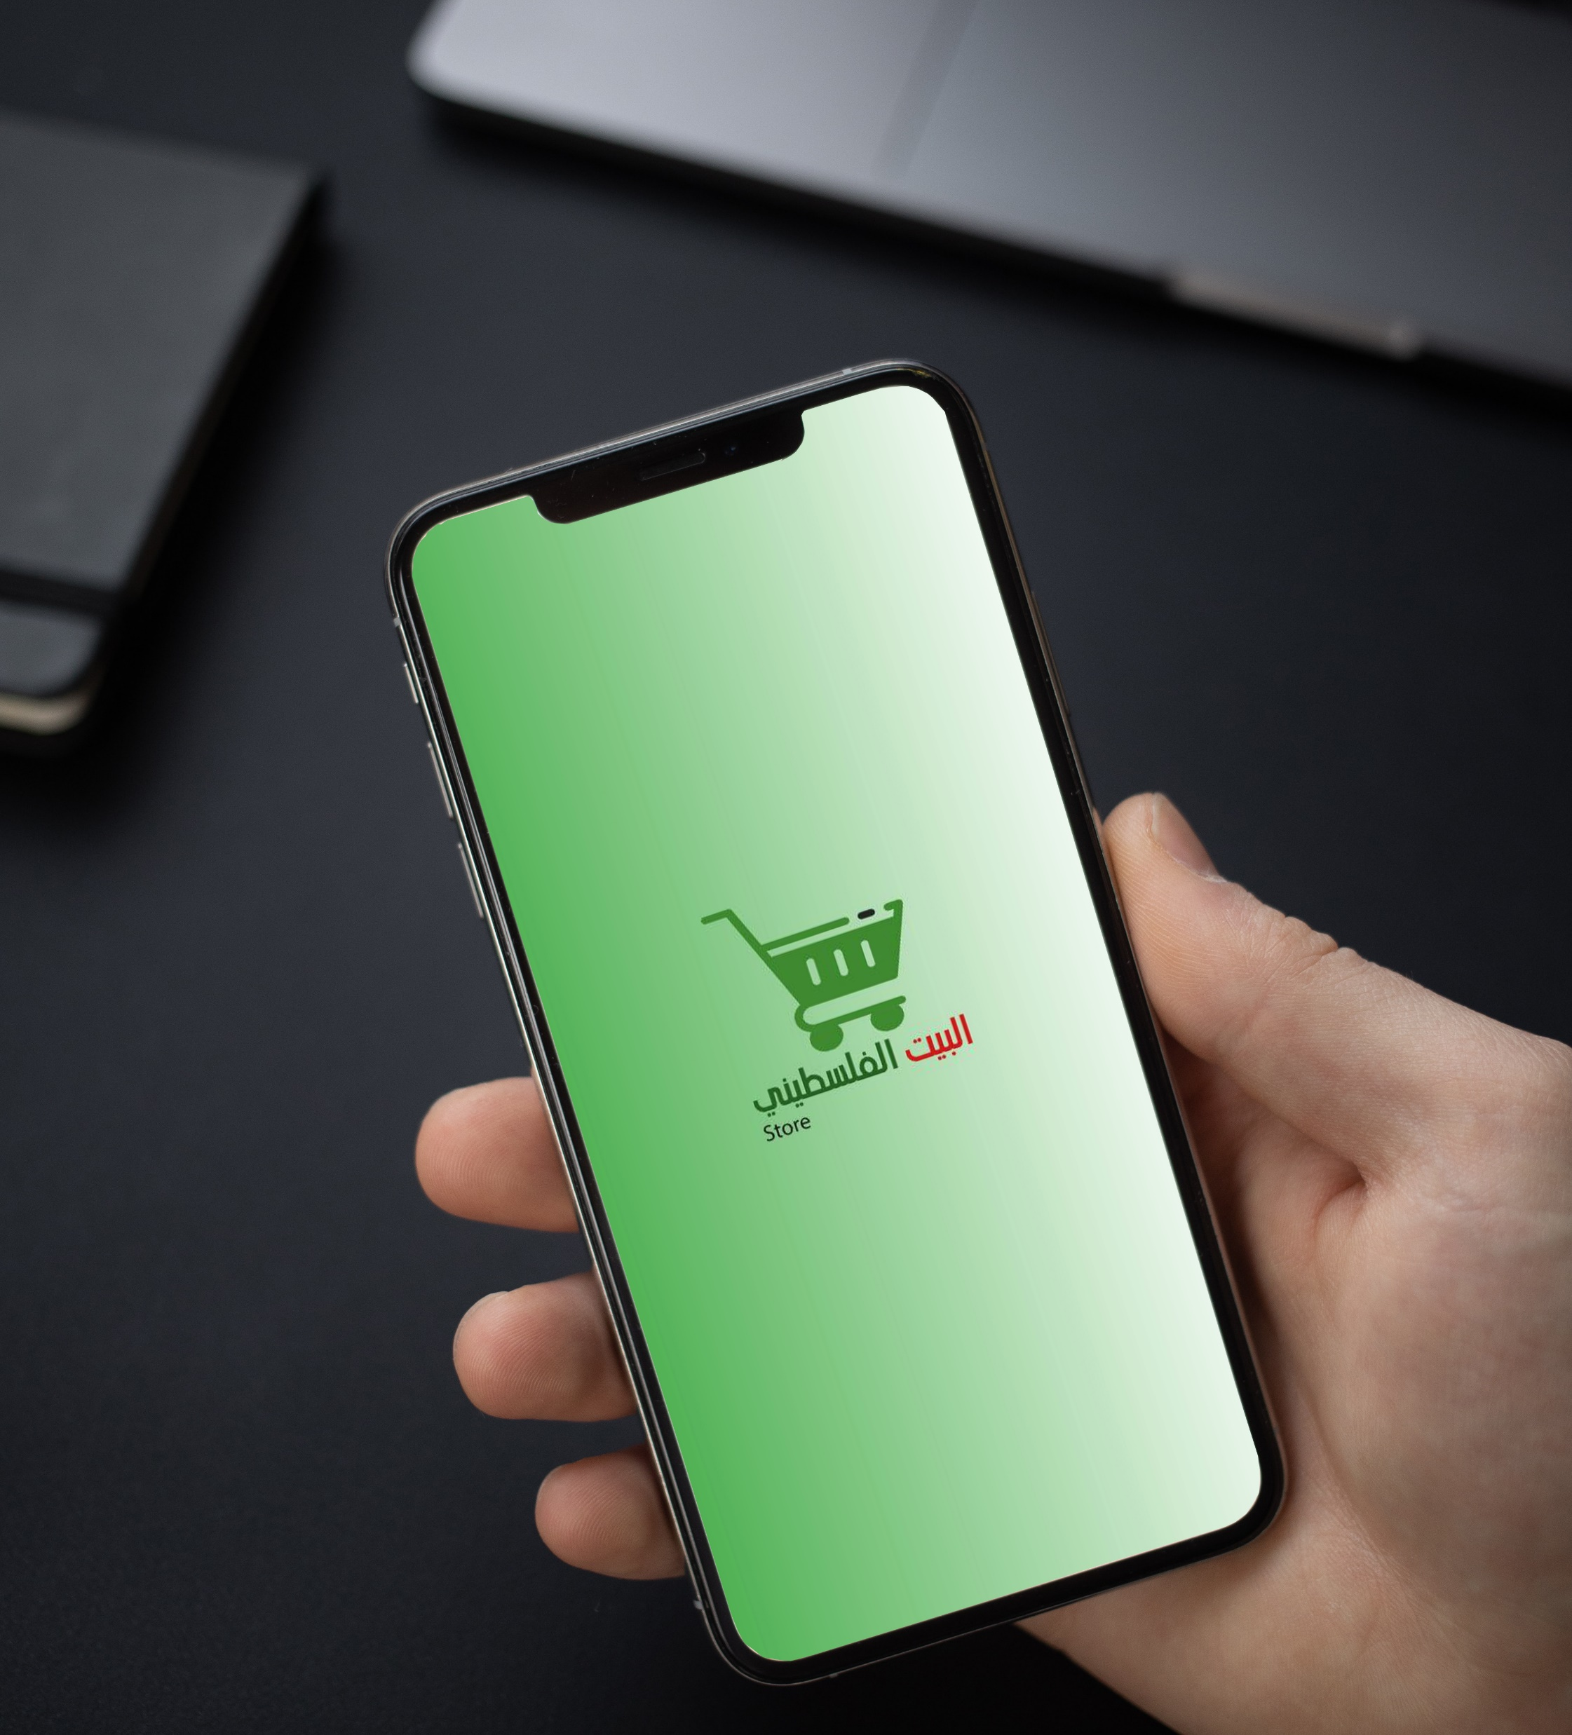
Palestinian House Store

Slide 2

Our Team:
Mohammed Al-Sharif
Suleiman Abu Jazar
Tariq Siksik
Osama Othman
Supervisor:
Dr. Hassan Dawoud
Eng. Sahar Abu Al-Khair

Slide 3
Presentation Path
Introduction
Proposed Solation
Related Work & Evaluation
1
3
5
2
4
6
Problem Statement
Testing & Results
Future Work

Slide 4
Problem Statement
Some families or individuals establish their own projects based on the sale of home-made products, and these families suffer from the difficulty of marketing their own product, and showing it to the largest number of people, which leads to a lack of sales and profit and sometimes loss, and sometimes the project is closed .

Slide 5
Proposed Solution
Palestinian House is a store application that displays and markets handmade products. The application displays all the sellers available on it, and show their products.

Slide 6
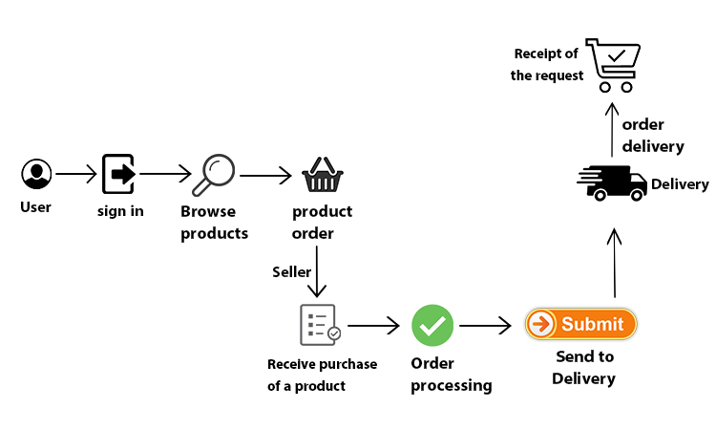
System Architecture Diagram

Slide 7
Testing & Results

Slide 8
Application Testing
Test the creation of a new account for each of the user, seller and delivery.
Test the login process for the user, seller and delivery.
Test the process of logging into the application in the right and wrong way.
Test the side menu and its functions.
Test adding a new list of products.
Test adding new products to the list.

Slide 9
Application Testing
Test the process of locating the place through Google Maps.
Test the appearance of the order data.
Test whether the order has been delivered or not.
Test the use of the delivery of Google Maps.
Application miss test to fill in a very important field.
Testing the appearance of the deletion message when deleting an order, list or product.
Testing the logout process for the user, seller and delivery.

Slide 10
Application Results

Slide 11
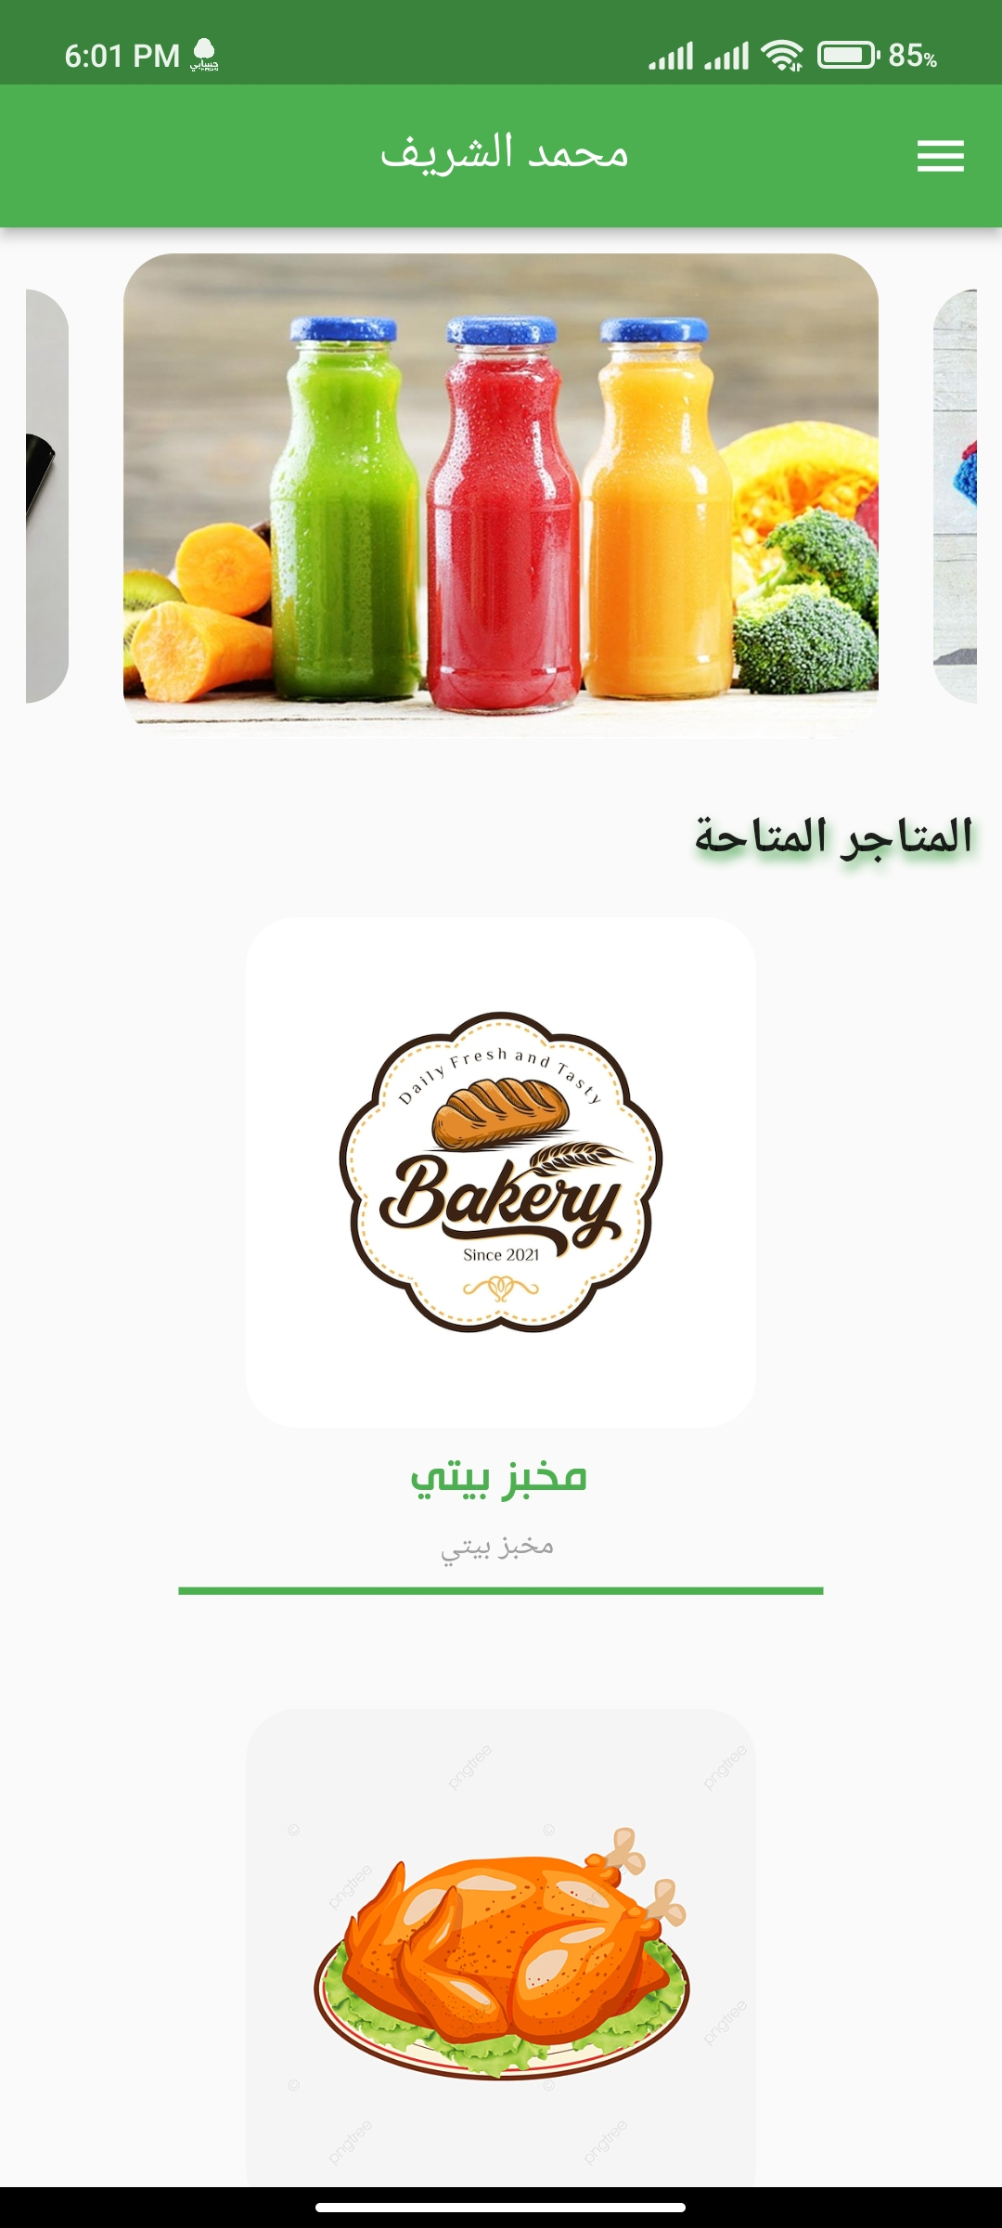
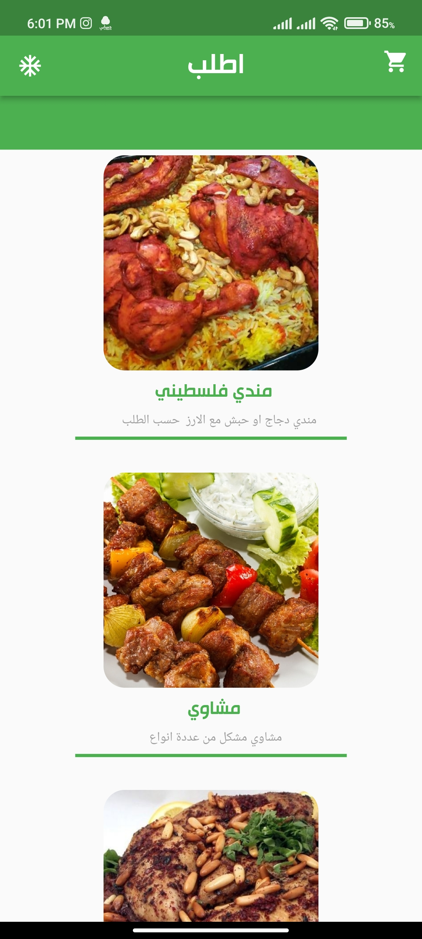
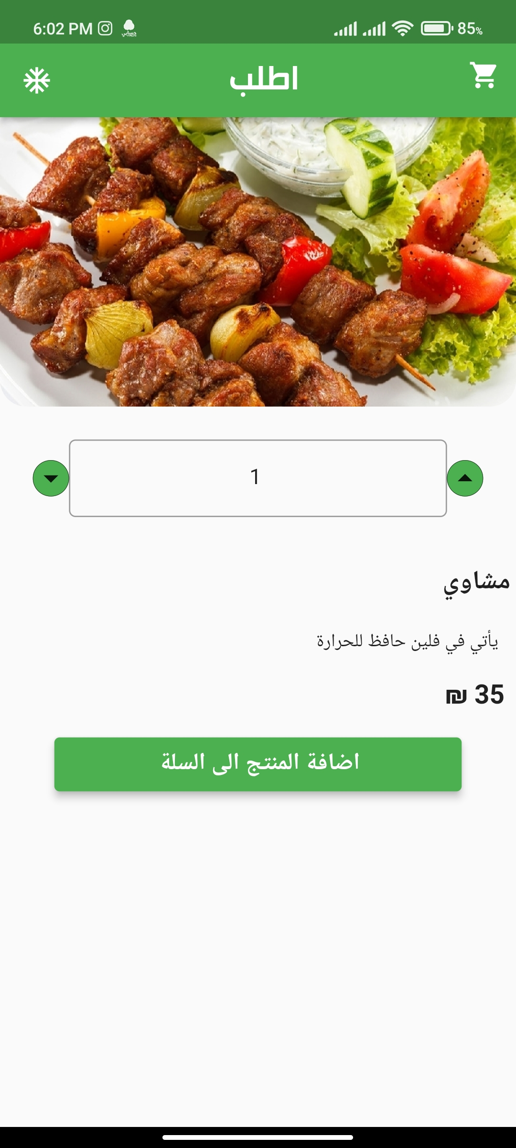

Slide 12
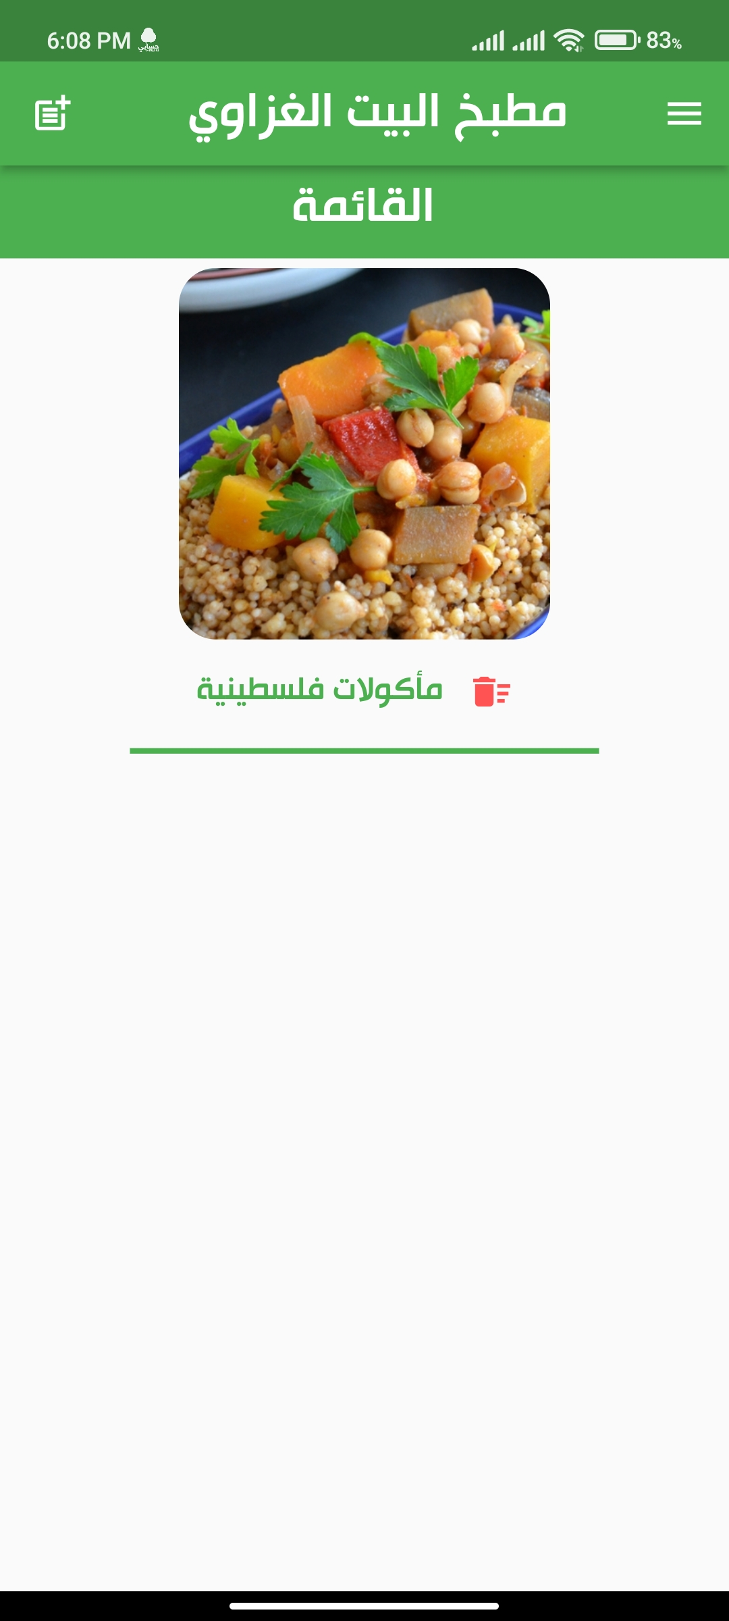
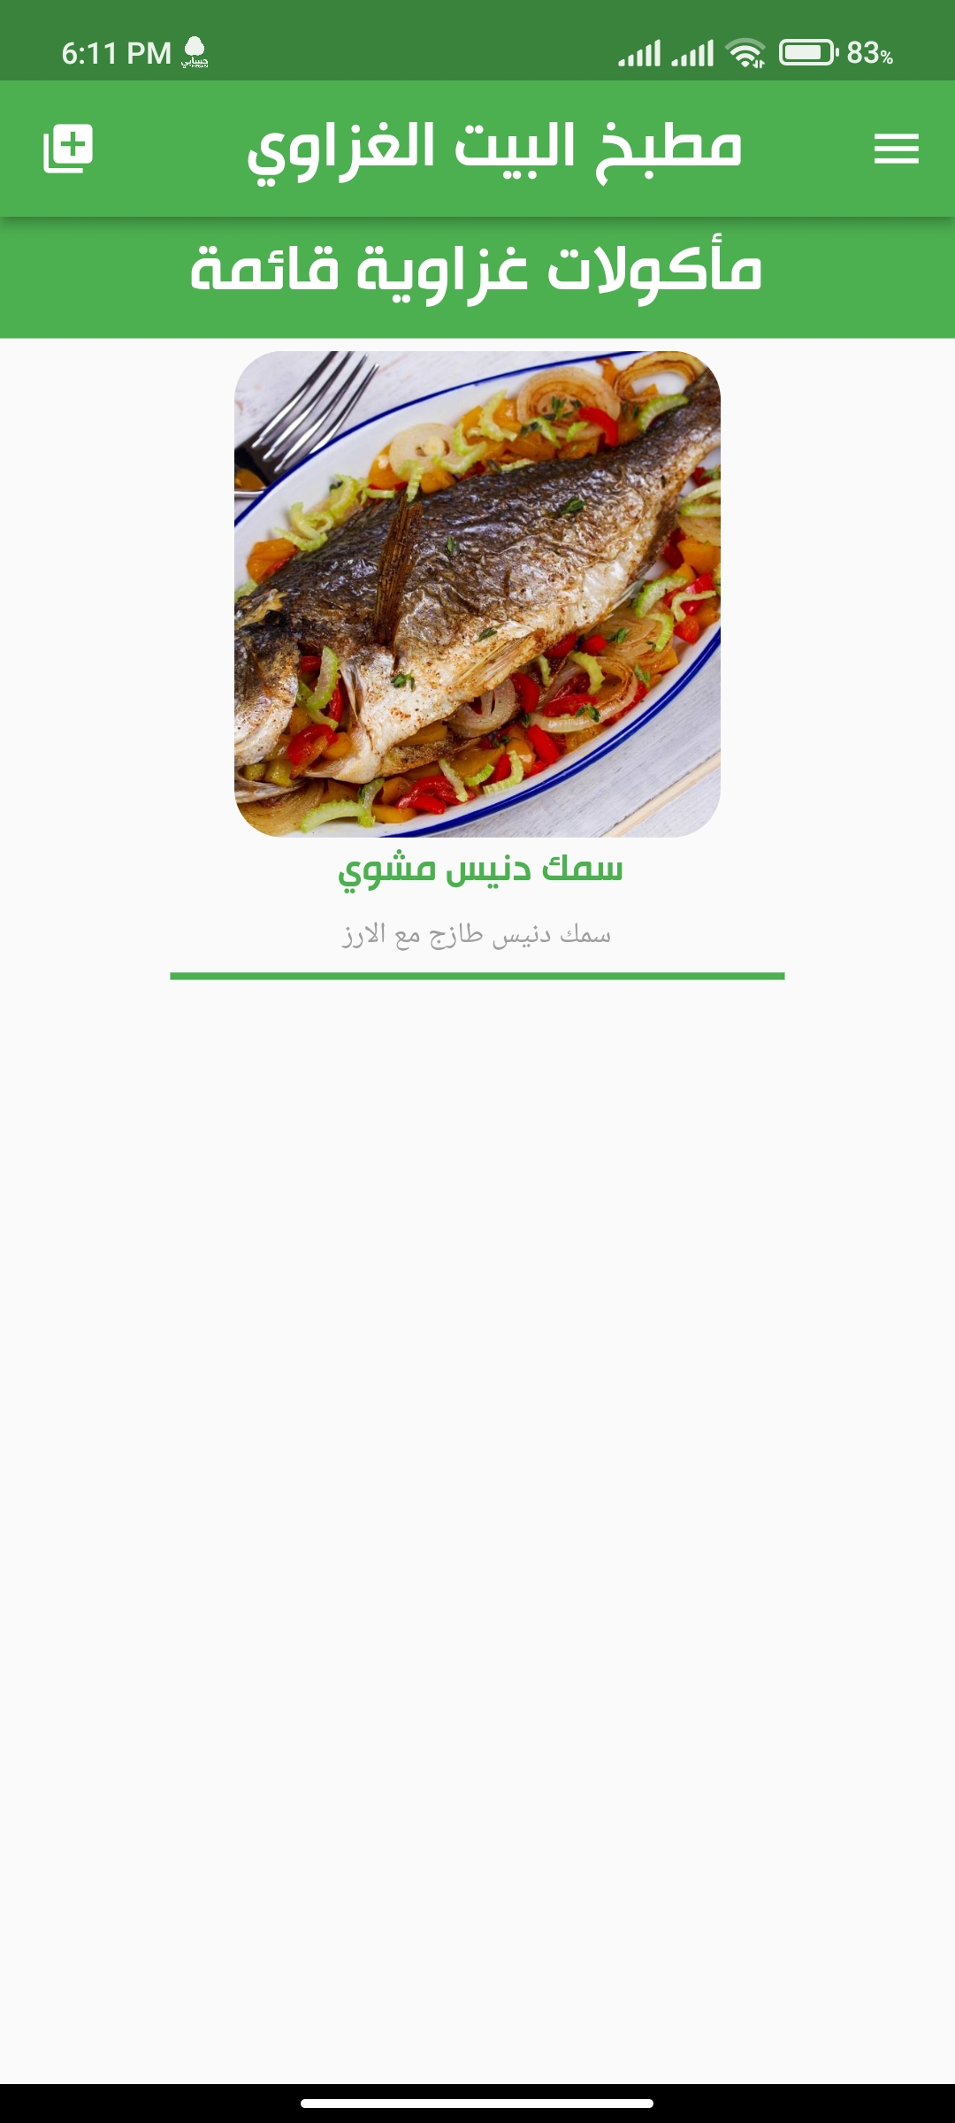
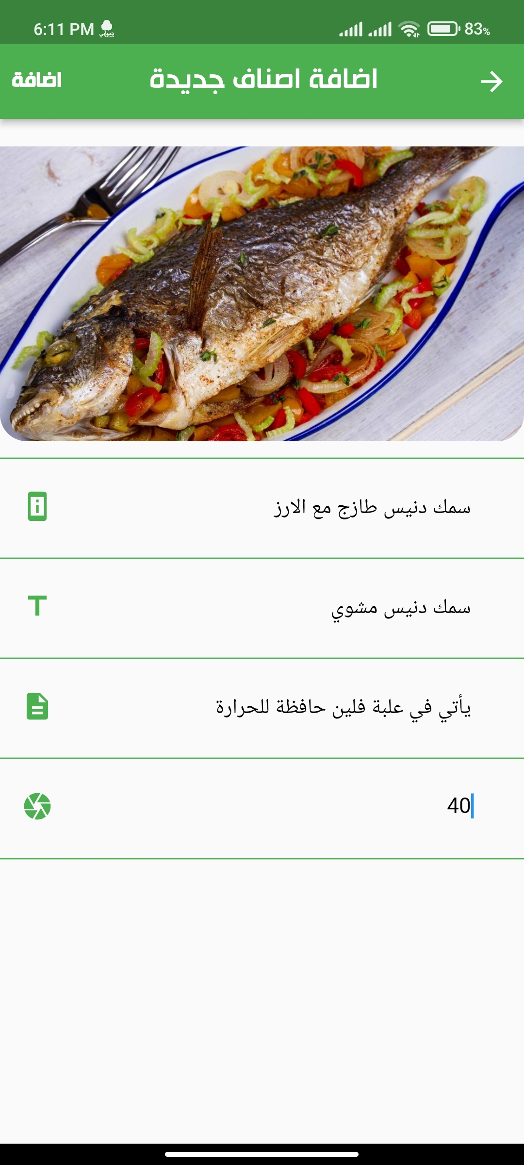

Slide 13
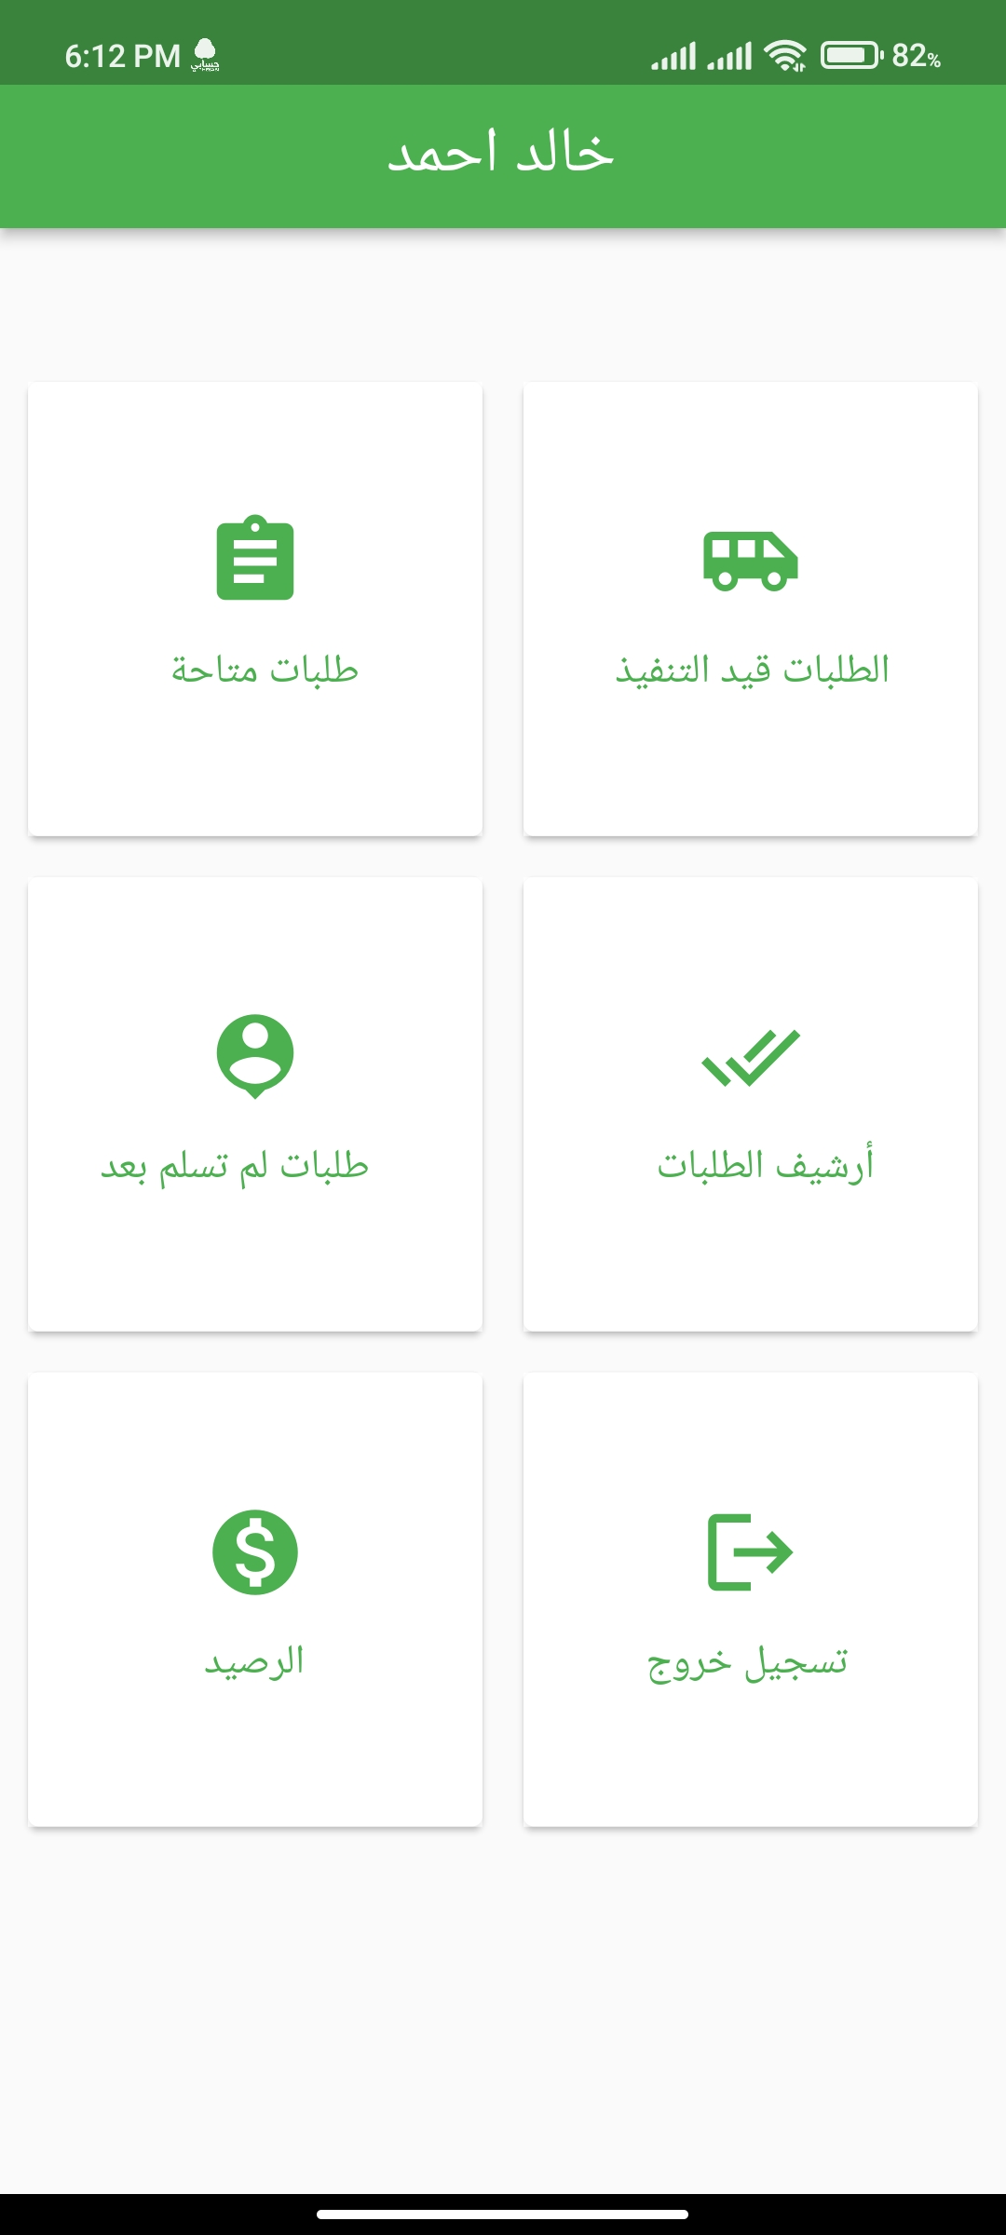
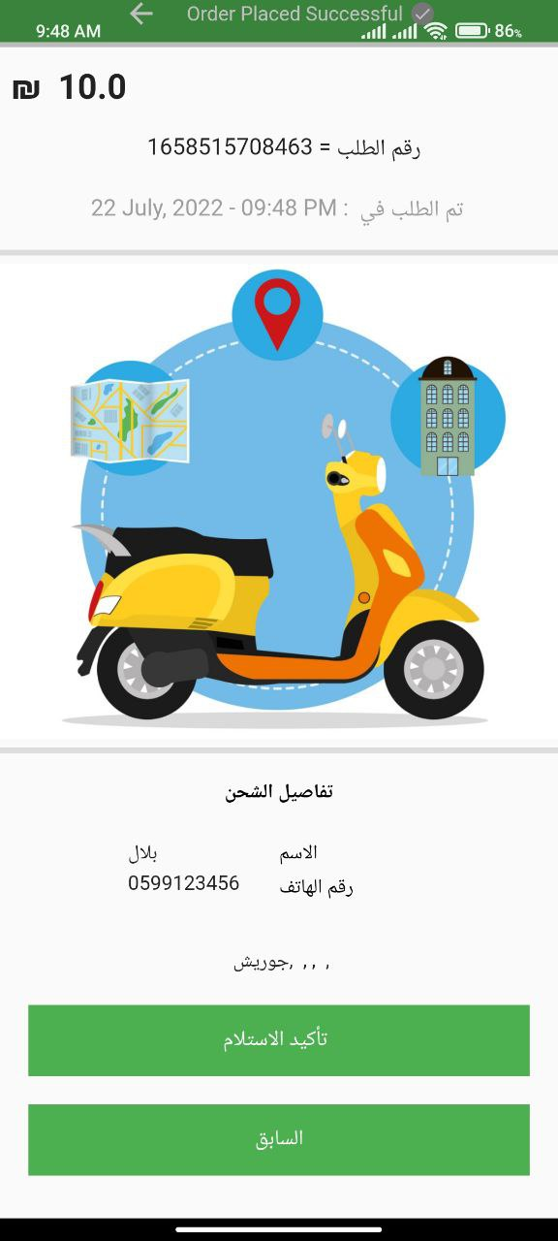
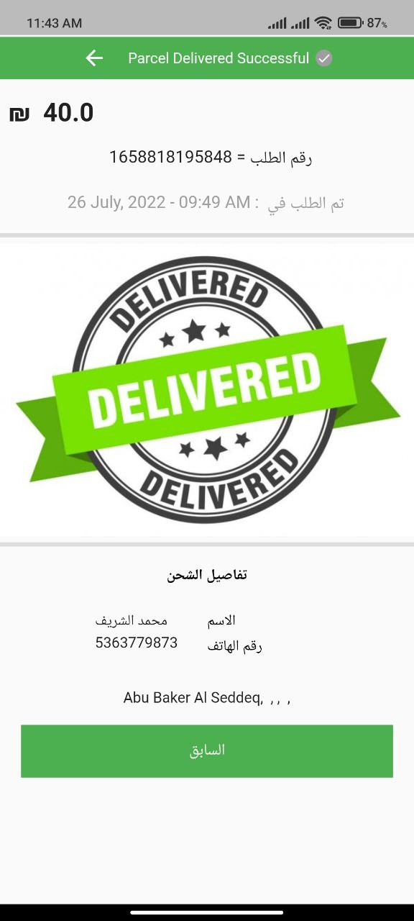

Slide 14
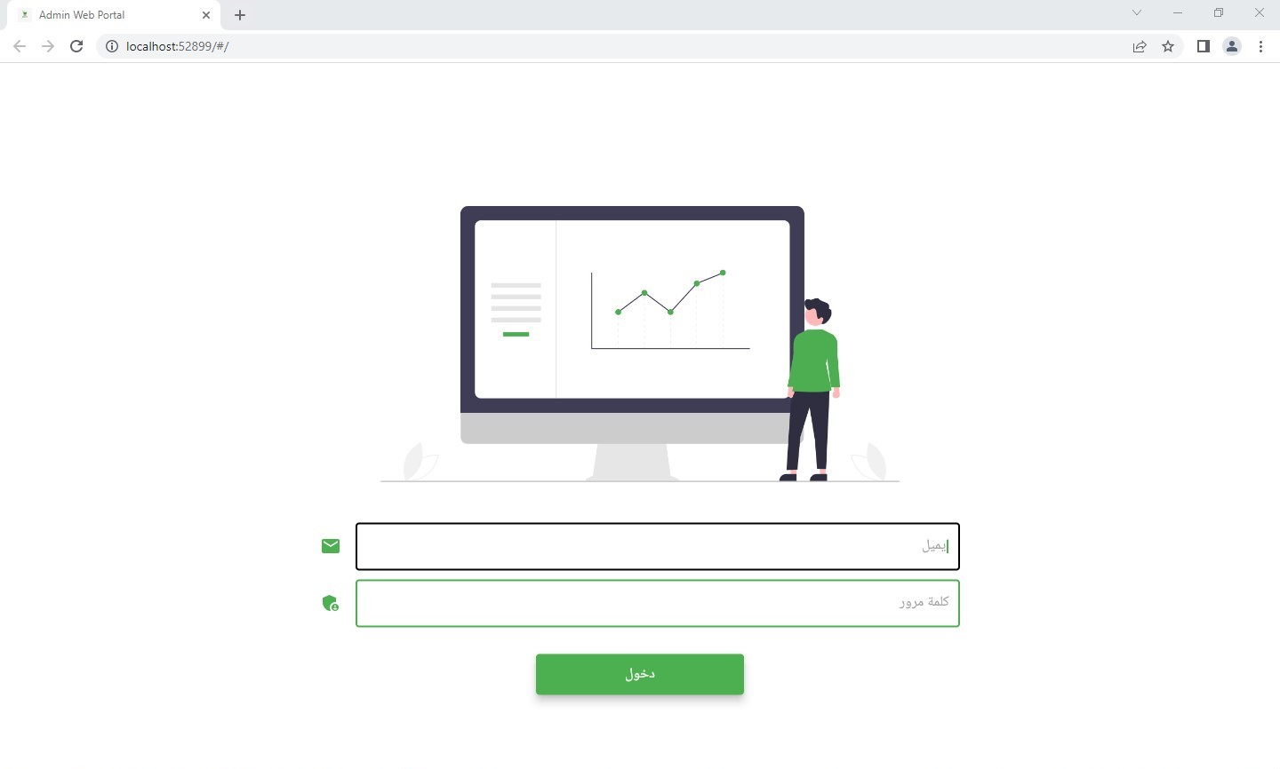
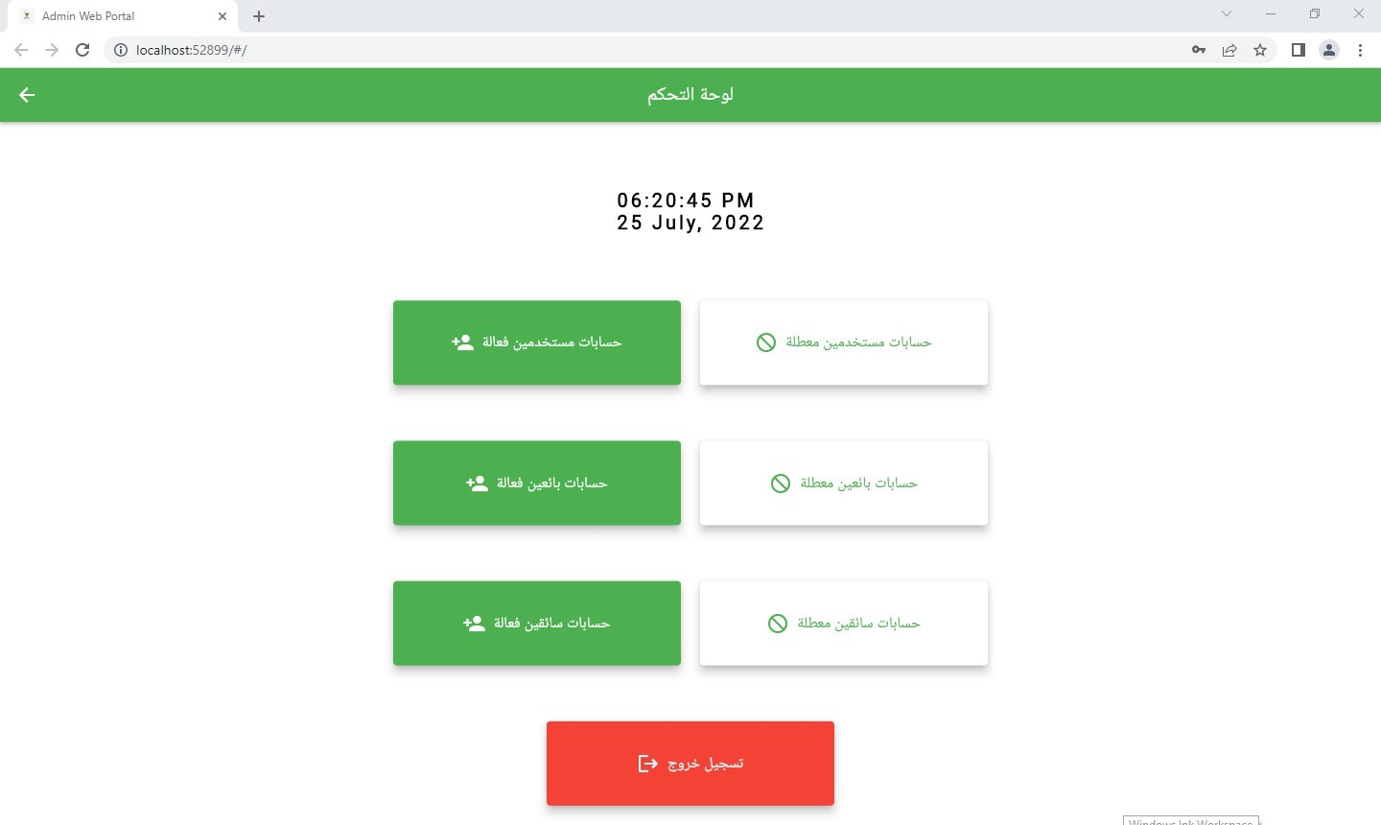

Slide 15
Related Work & Evaluation

Slide 16
Related Work
Palestinian House | Jumia website | Sender app | Azeez app | Comparing
App | Website | App | App | system shape
Home and handmade products | All kinds of products | Products of restaurants, shops and pharmacies | All kinds of products | Products being marketed
Gaza script | Egypt | Gaza script | Gaza script | Geographical location
Cash | Cash or by card | Cash or by card | Cash | Payment method
No | Yes | No | Yes | Having discounts
Yes | Yes | Yes | Yes | Delivery

Slide 17
Evaluation
Usability Evaluation
Functional Evaluation
Performance Evaluation

Slide 18
Usability Evaluation

Slide 19
Functional Evaluation
 | Question | Yes | No
Add Function | add products | *
 | add users
 | Add sellers
 | Add Delivery
 | Add location coordinates
Retrieve Function | Retrieve Order Money | *
 | Retrieve Delivery money |  | *
Delete Function | Delete Order | *
 | Delete item list
 | Delete item

Slide 20
Performance Evaluation
 | Current system | Our solution
time | 12 hour – 1 Day | 2 – 5 hours
Fraud | High | Low
security | Middle | High
Location in map | mostly not | Existing
return order | mostly not | Existing

Slide 21
Future Work
Expand the application to include stores, companies, etc.
Adopting new items in the application, such as household and electrical appliances, and imported clothes.... etc.
The possibility of creating a delivery team for the application.
Support for applications in other languages.
Adding a rating for the sellers and adding comments to the users on the product.

Slide 22
Future Work
Add notifications to the application.
The work of a support and inquiries team to receive complaints about the application.
Setting terms and conditions for the application.

Slide 23

Thank you for Listening
Any Questions?

